Slide 1
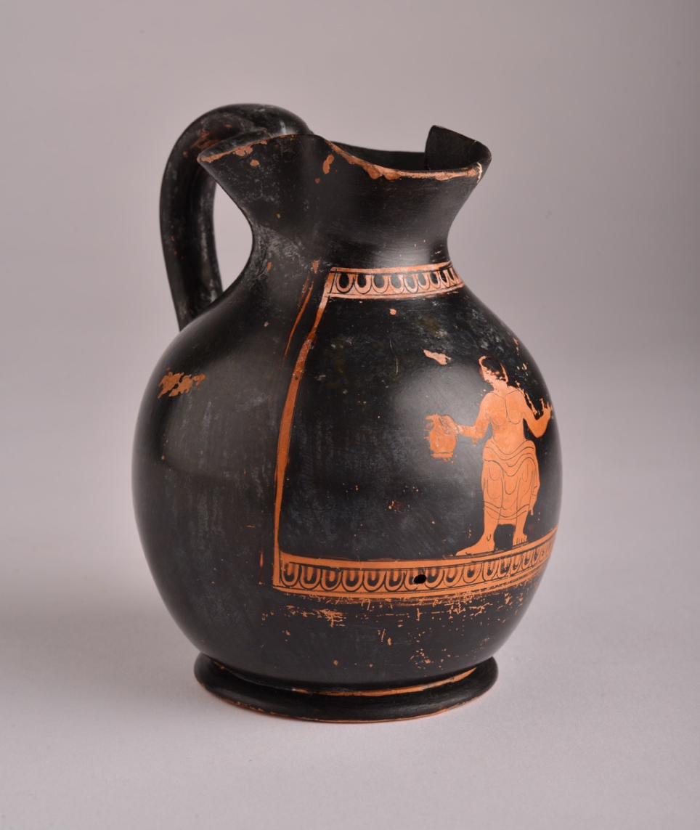
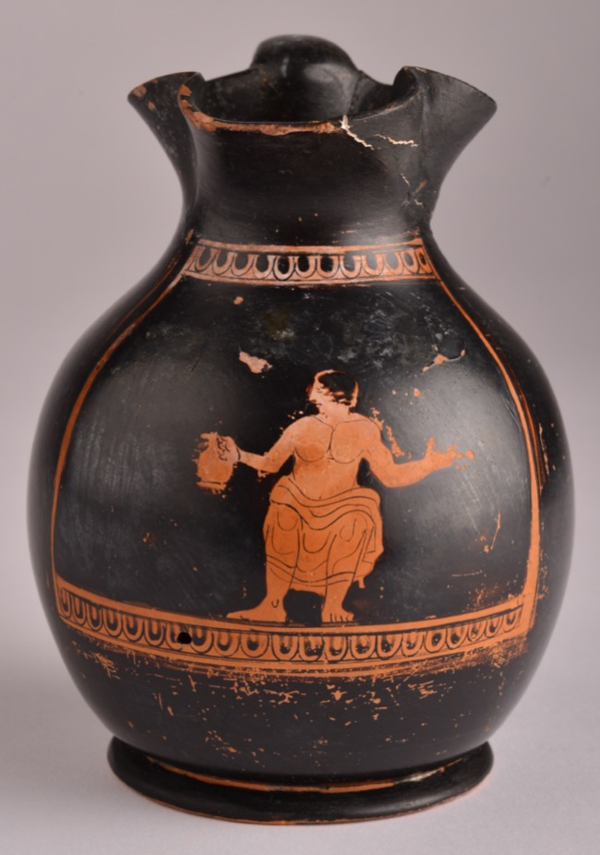
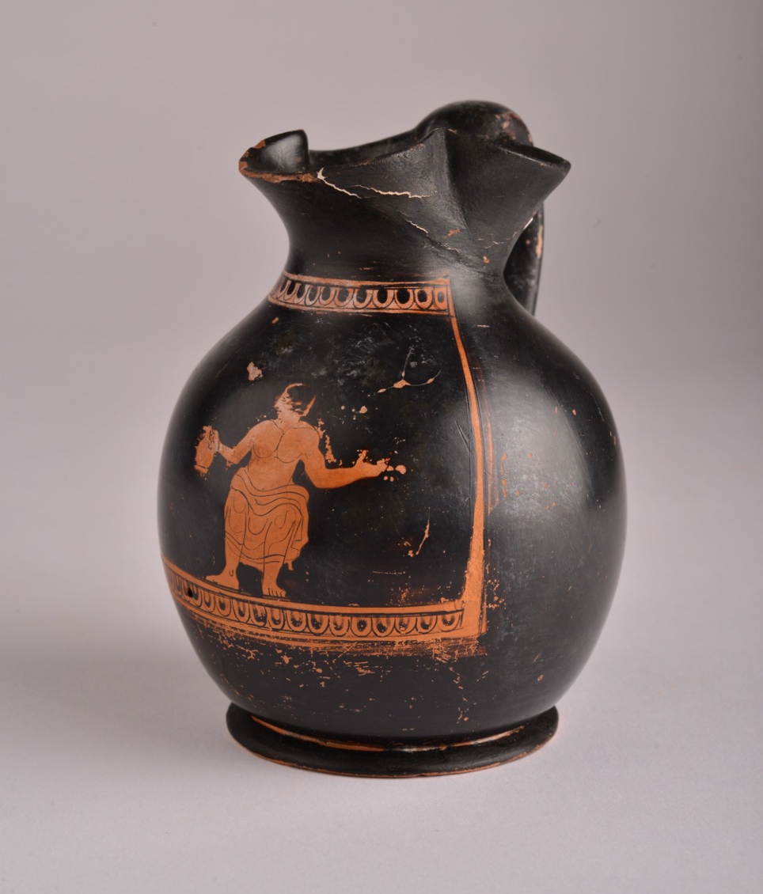
GROWING UP Children in Ancient Greece

Slide 2
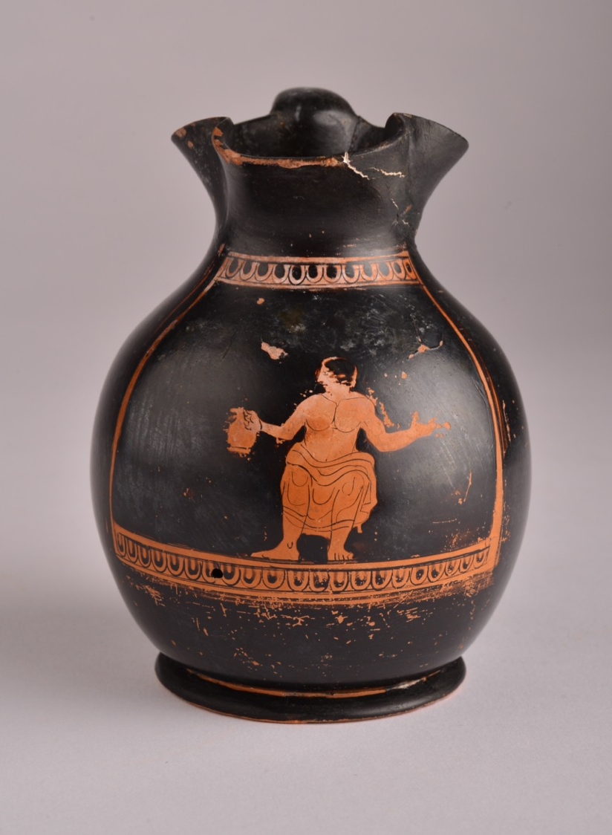
Chous (198)
The artefact we are looking at today is a type of jug, a chous. It was used for pouring liquids like wine.
Smaller chous were often children’s objects and many of them are decorated with scenes showing children.
198 is the chous’ accession number – this is the special number used (like a name) to identify the chous in the Great North Museum: Hancock.
The chous was made near Athens in Greece, between 450 and 400 BCE – so around 2450 years ago.
The chous is made from clay. It was decorated with paint and then fired in a kiln (a very hot oven).

Slide 3
Chous (198)
The chous is painted in a red-figure style: the background and the details of the picture are painted in black whilst the figures are an orange/red colour, because they have not been painted and are the colour of the clay underneath.
The picture on the chous shows a man or a boy. His face faces the side. He has black hair. He has some clothes draped around his hips, and he has muscles on his chest. He holds out his hands, and in his right hand he holds a little chous.
Can you see his clothes?
Can you see the chous in his hand?

Slide 4
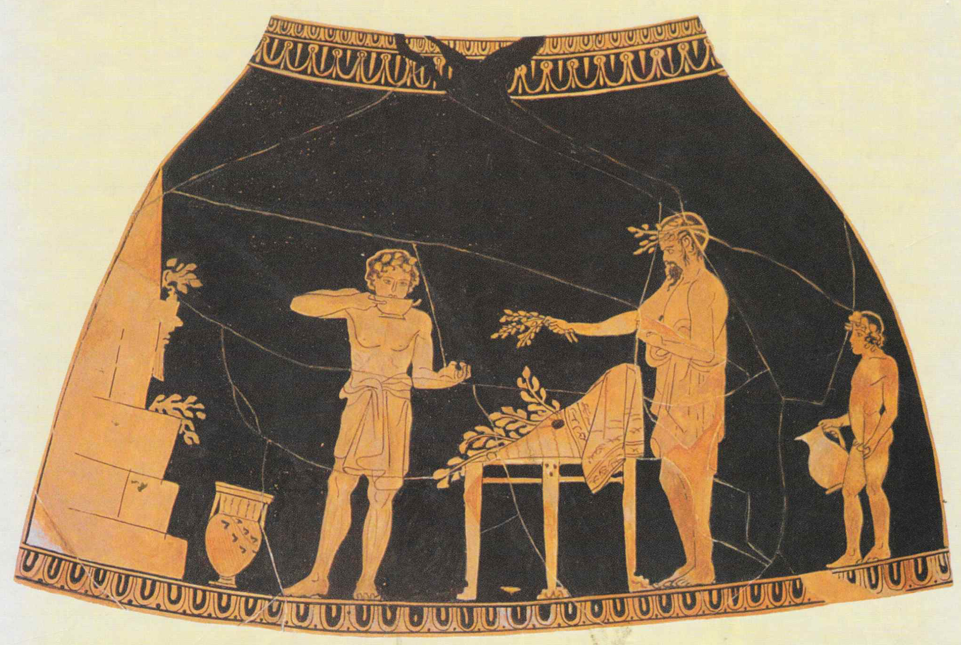
Using Choes Growing Up in Ancient Greece
This picture shows a boy, a man and an older boy getting ready for a festival called the Anthesteria.
The picture is from a chous jug – it has been folded out by a computer so that you can see all of it.
The Anthesteria was a special festival that children went to when they were 3 years old.
When children went to the Anthesteria, they had their first drink of wine from a chous jug. This welcomed the child into their society.
Can you see that the younger boy holds a chous?

Slide 5
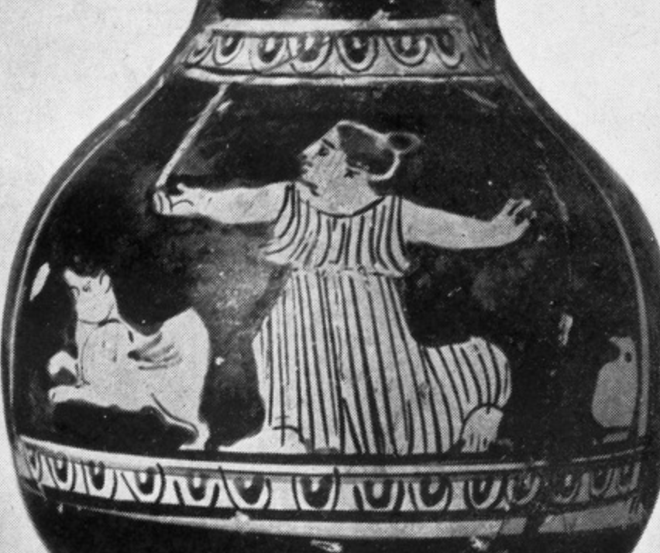
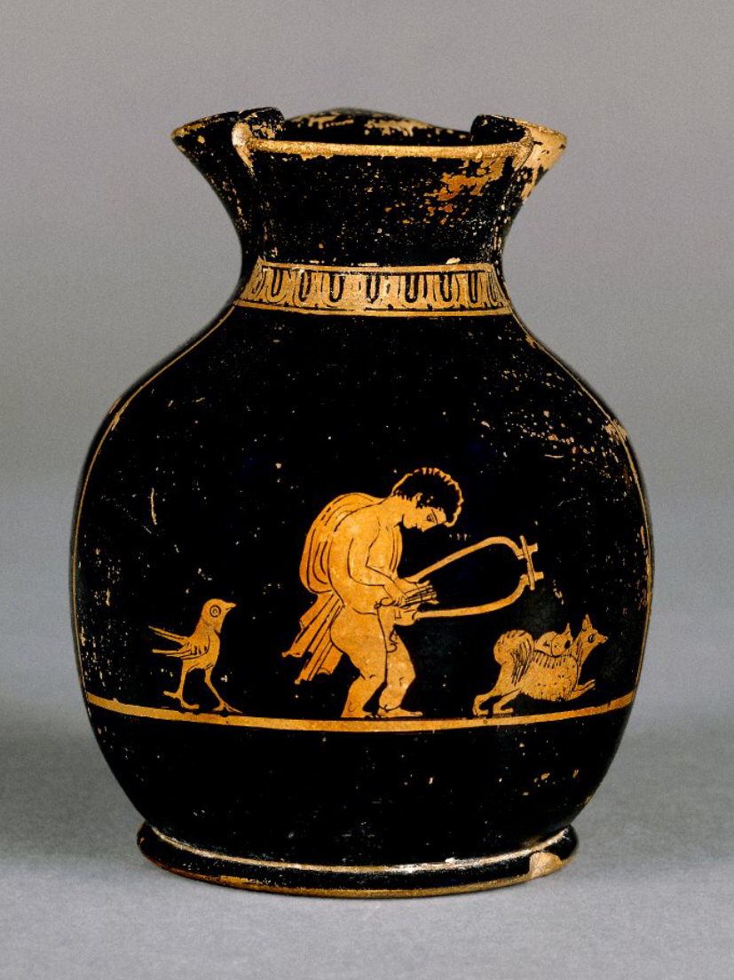
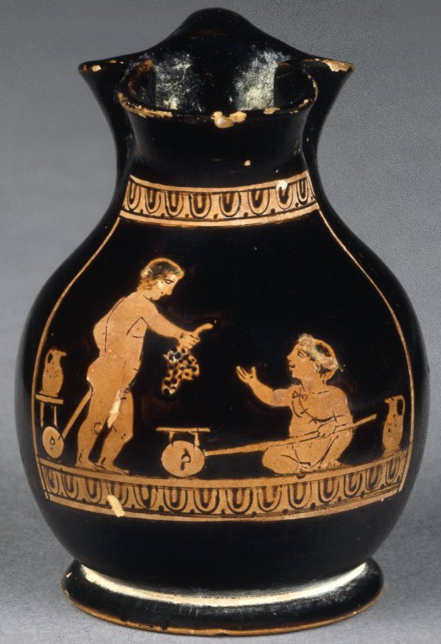
More Choes
These are some other choes from ancient Greece that are kept in museums in England and in Greece.
You can see they are a little different from our chous – they have different pictures on them (some show girls and some show more than one child), and they can be a different size (some are bigger and some are smaller). They all show children having fun though, don’t they?

